Slide 1


Analysis of Bitcoin Price Prediction Using Machine Learning
Junwei Chen
Graduate School of Economics, Kobe University
Journal of Risk and Financial Management (JRFM), Vol 16(1), Article 5
January 2023
Presenters: Nithin Sunil, Huan Yang and Ognjen Davidovic

Slide 2
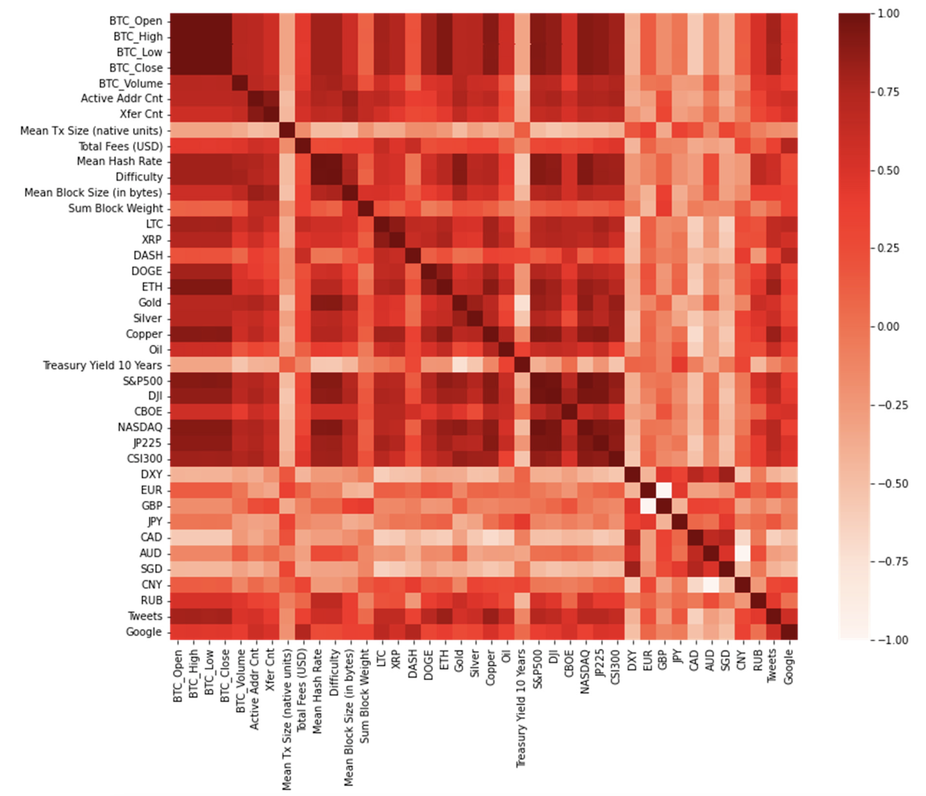
Research Problem & Motivation
Problem: Bitcoin's high volatility (3.85% daily return std dev - 2.68x gold, 3.36x S&P500)
Swings 3-4% daily vs. 1% for stocks
Investors need predictions to minimize risk
Most AI models can predict prices BUT can't explain why
Challenge: How to predict next-day Bitcoin price to minimize investment risk
Bitcoin reached $68k in Nov 2021, market cap exceeded $1.2 trillion
Research Gap: Most studies use LSTM; Random Forest Regression underexplored for Bitcoin
Motivation: Need explainable predictions not just "black box" neural networks that can't tell if model learned real patterns or just noise

Slide 3
Dataset & Feature Overview
47 Features Across 8 Categories:
Category | # Features | Examples
Bitcoin Price | 5 | Open, High, Low, Close, Volume
Bitcoin Technical | 8 | Hash rate, difficulty, active addresses, fees
Other Cryptos | 5 | ETH, LTC, DOGE, XRP, DASH
Commodities | 5 | Gold, silver, oil, copper, 10-yr Treasury
Stock Indices | 6 | S&P500, NASDAQ, DJI, VIX, JP225, CSI300
Foreign Exchange | 9 | USD index, EUR, GBP, JPY, CAD, etc.
Public Attention | 2 | Google Trends, Twitter mentions
Week Dummies | 7 | Monday-Sunday
Data:
Period: March 31, 2015 - April 1, 2022 (2,559 daily observations)
Why split?
Two major bubble periods (2017, 2021)
Period 1: 2015-2018 (train 85.7%, test 14.3%)
Period 2: 2018-2022 (train 85.7%, test 14.3%)

Slide 4

How They Predicted Bitcoin Price​
Model 1: Random Forest
What it is:
Think of 500 different "decision trees" voting together
Each tree asks questions like: "Is NASDAQ up? Is Ethereum rising? Is Bitcoin's current price high?"
Final prediction = average of all 500 votes
Pros:
Can explain decisions: "NASDAQ mattered 35%, Ethereum 20%, Oil 15%..."
Shows which factors are most important
Transparent - can see the logic
Cons:
Can't predict prices higher than it's ever seen before (Example: Struggled when Bitcoin hit $60k+)
Model 2: Neural Network (LSTM)
What it is:
Brain-like learning system with 4 layers processing data
Learns patterns from historical sequences
Popular choice in Bitcoin prediction research
Pros:
Very accurate for time series data
Captures complex patterns automatically
Current "gold standard" in literature
Cons:
"Black box" - can't explain WHY it made a prediction
Just says "Bitcoin will be $45k" without showing reasoning

Slide 5

Data Preparation
Normalization (Min-Max Scaling):
Technique: Scaled all numbers to 0-1 range
Why needed: Different features have wildly different scales
Example: Bitcoin price = $50,000 vs Oil change = 2%
Without scaling: Model thinks Bitcoin price is "more important" just because numbers are bigger
How it works: (value - minimum) / (maximum - minimum)
Missing Data (Forward Fill):
Problem: Stock markets closed weekends/holidays, but Bitcoin trades 24/7
Technique: Used Friday's value for Saturday/Sunday
Why this approach: Assumes prices stay constant until markets reopen (conservative assumption)
Proper Train/Test Split:
Technique: Trained on past data (2015-2021), tested on future data (2022)
Why critical: Prevents "data leakage" - model must predict truly unseen future
Fair test: Model can't "peek" at test answers during training

Slide 6
Results & Evaluation Metrics
Key Metrics Used:
RMSE (Root Mean Squared Error): Absolute prediction error
MAPE (Mean Absolute Percentage Error): Scale-independent error (%)
DA (Directional Accuracy): % correct up/down predictions
Period 1 (2015 -2018)
Model | RMSE | MAPE ↓ | DA (%)
Random Forest | 321.61 | 3.39% | 51.93%
LSTM (avg of 30 runs) | 330.26 | 3.57% | 49.98%
Period 2 (2018 -2022)
Model | RMSE | MAPE ↓ | DA (%)
Random Forest | 2,096.24 | 3.29% | 52.49%
LSTM (avg of 30 runs) | 3,045.87 | 4.68% | 48.09%

Slide 7
How it Relates to Our Project
Key Differences:
Our Project:
5 models (vs Chen's 2) + K-Fold validation + includes interest rates
Paper Focus:
Random Forest Regression (RFR)
Long Short-Term Memory (LSTM)
Shared Foundation:
Same 6 core features: Bitcoin OHLCV, S&P500, NASDAQ, DJI, Oil, ETH
Feature Trade-off:
Us: 13 focused features (+ interest rates, Gold, VIX)
Chen: 47 comprehensive features (+ other cryptos, JP225, blockchain data, sentiment)
Aspect | Chen (2023) | Our Project
Goal | Predict next-day BTC price | Predict BTC price
Task | Time series regression | Time series regression
Models Tested | 2 (Random Forest, LSTM) | 5 (ARIMA, KNN, LSTM, XGBoost, LightGBM)
Validation | Single 85/15 split | Time-Series K-Fold CV
Features | 47 variables | 13 variables

Slide 8
Key Findings: The Structural Market Shift
The Traditional Finance Era
Period 1 (2015–2018)
NASDAQ
S&P 500
Dow Jones (DJI)
Oil Prices
Key Insight: 3 of the top 6 factors were US Stock Indices. Bitcoin behaved like a risky tech stock.
"The Crypto & Global Era"
Period 2 (2018–2022)
Ethereum
Nikkei 225
DOGE
Key Insight: US Stocks (NASDAQ) lost importance. The market shifted to "Crypto-to-Crypto" and Asian markets.

Slide 9
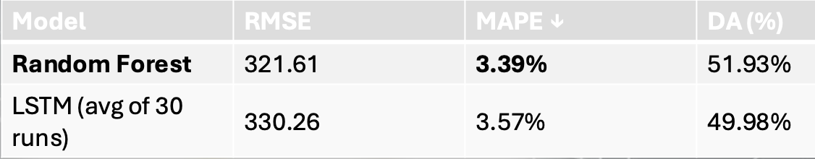
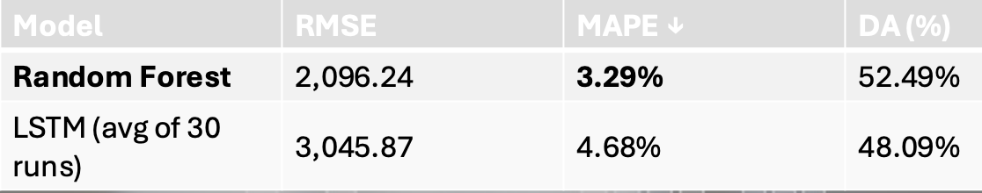
Evaluation Metrics: Accuracy vs. Trading Utility
Period1(2015-2018)
RMSE (Error Magnitude) Value: ~3,000
MAPE (Percentage Error) Value: ~3.5% - 4.5%
Directional Accuracy (DA) Value: 52.49%
Key Insight: Random Forest outperformed LSTM in Directional Accuracy
Period2(2018-2022)
RMSE (Root Mean Squared Error): Absolute prediction error
MAPE (Mean Absolute Percentage Error): Scale-independent error (%)
DA (Directional Accuracy): % correct up/down predictions

Slide 10
Relation to Project: Benchmarking Our Architecture
"Head-to-Head" Comparison Table
 | Chen (2023) | Our Proposal
Features | 47 | 13(Bitcoin Open & high...)
models | 2 (RF, LSTM) | 5(ARIMA, LSTM...)
Validation | Single Split | Time-Series K-Fold

Slide 11
Insights & Adopted Methodologies
Inspiration:
Structural Decoupling: Discovery that Bitcoin shifted from (NASDAQ) to Global/Asian markets
Metric Utility: Finding that "Directional Accuracy"
Model Limitations: Observation that complex "Black Box" models (LSTM) performed worse
Improvement:
Noise Reduction: Chen's 47 features down to 13 Features to remove noise
Model Expansion: 5Models
Rigor Upgrade: Replacing single "85/15 Split" with Time-Series K-FoldCross Validation

Slide 12
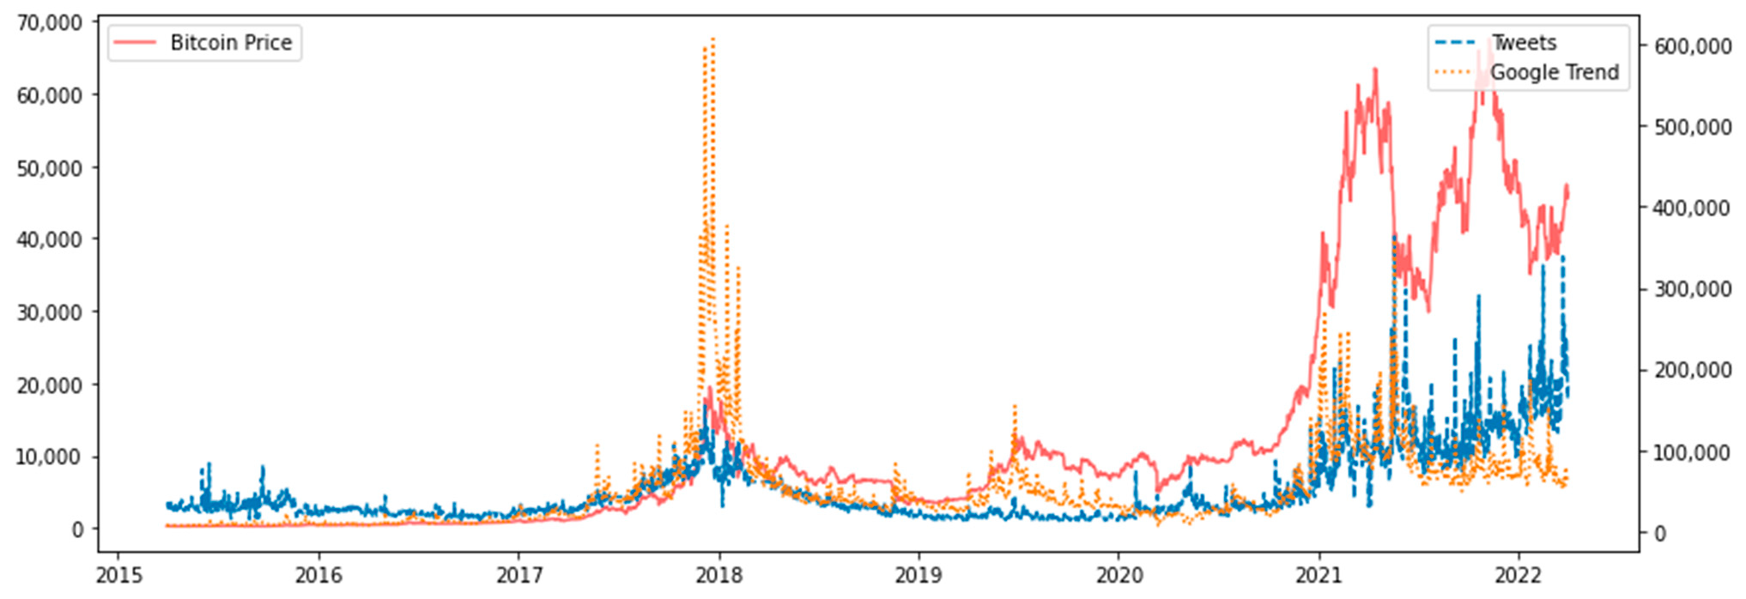
Our Project Goals and The Research
Our Team’s Goal:
• To build a robust model for short- and medium-term Bitcoin price prediction.
• We use market, network, and economic signals to predict daily and weekly closing prices.
The Challenge:
• Bitcoin is extremely volatile. Its daily return standard deviation during the seven-year study period was 3.85%. This makes accurate forecasting crucial for reducing investor risk.
Research Paper Insight:
• We reviewed a paper comparing two key prediction tools for forecasting the price on the next day:
◦ Random Forest Regression (RFR) (simpler, explainable model)
◦ Long Short-Term Memory (LSTM) (complex neural network)
Figure 5. Google Trend, daily Tweets, and Bitcoin price chart.

Slide 13
Crucial Data and Metrics to Add
Metrics to Add
MAPE (Mean Absolute Percentage Error)
Average prediction error as % (Chen: 3.4-4.7%)
Value: Scale-independent - can compare across different Bitcoin price levels ($10k vs $60k)
DA (Directional Accuracy)
% of predictions with correct up/down direction (Chen: 51-52%)
value: Trading usefulness - more important to know trend than exact price
Feature to Add
JP225 (Nikkei 225 - Japanese Stock Index)
Bitcoin trades 24/7 globally - Asian markets matter when US markets closed, captures international market influence
Chen found this became critical in Period 2 (2018-2022)
Analyses to Run
Feature Importance Rankings
Which of our 13 features matter most for predictions
Discover if our interest rate feature dominates
Period-Based Comparison (Pre/Post 2022)
Split data before/after Fed rate hikes began (March 2022)
Test if interest rates became critical factor in bitcoin pricing and helps comparison of structural economic change

Slide 14
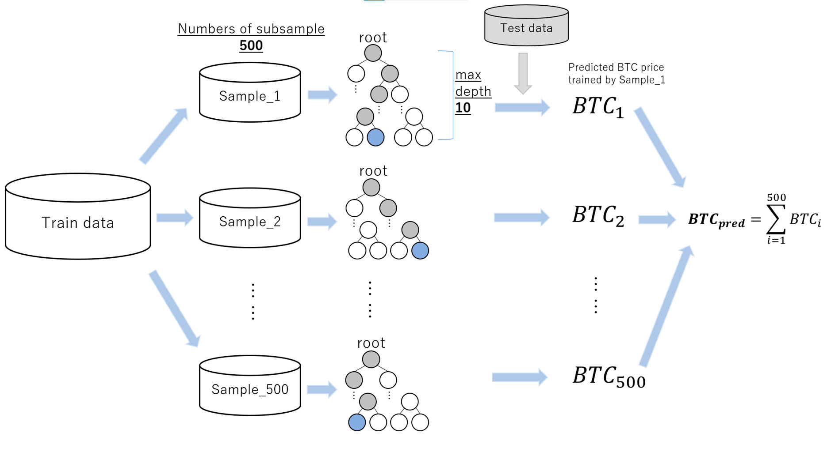
RFR Strength: Explainability and Accuracy
RFR Performance Strengths:
• The analysis covered a long, volatile period (2015–2022), split into two sub-periods (P1/P2).
• RFR achieved generally higher prediction accuracy (lower errors) than LSTM in both periods.
The Key Benefit: Explainability:
• RFR is not a "black box". It is an ensemble of 500 regression trees.
• It explicitly provides the importance rank of each explanatory variable, which is crucial for understanding why the price is predicted to move.
Figure 1. Parameters and framework of random forest regression.

Slide 15
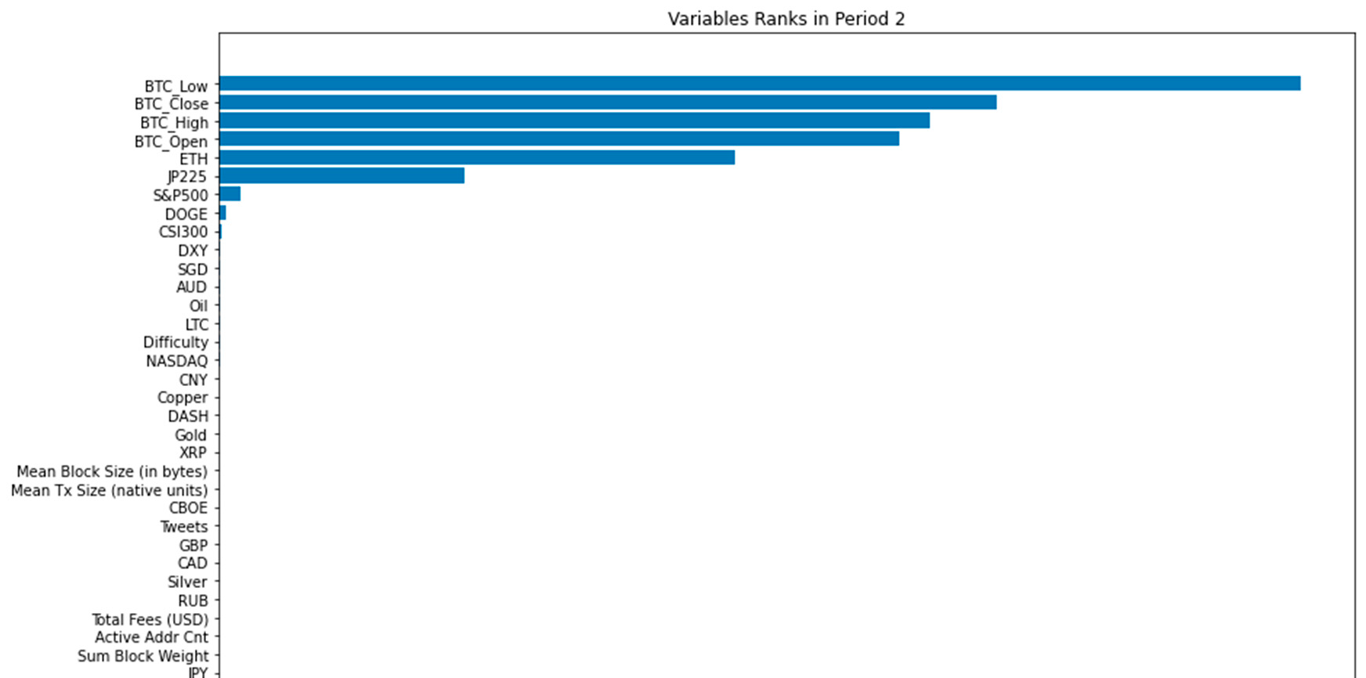
Shifting Market Drivers
RFR Reveals Dynamic Influences:
• Consistent Driver: Bitcoin’s own OHLC prices from the previous day were always the most important.
• Period 1 (2015–2018): Price was highly correlated with traditional US markets: NASDAQ, DJI, S&P500 indices, and crude oil.
• Period 2 (2018–2022): The importance of US stock indices decreased sharply.
• New Influences in P2: Focus shifted to the broader crypto market (ETH) and the Japanese stock index (JP225).
Figure 9. Explanatory variable importance ranks using random forest regression

Slide 16
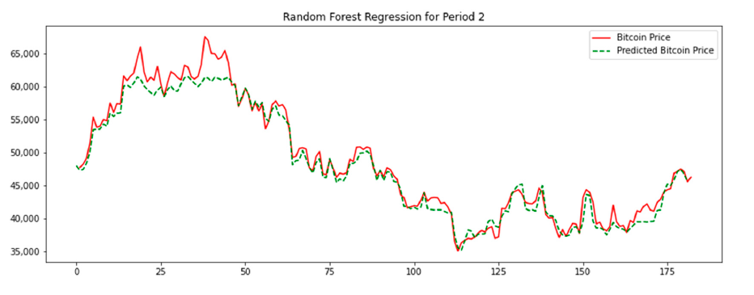
Key Model Limitations
RFR cannot accurately predict values that did not appear in the training data.
• It showed poor prediction when Bitcoin prices went over $60,000, as there were too few training samples at that high level.
Statistical Ambiguity:
• While RFR had better error numbers, statistical tests (DM and Clark–West) could not prove RFR was significantly better than LSTM at the 95% level.
LSTM Setup Complexity:
• LSTM is sensitive: Including redundant explanatory variables causes a decrease in prediction accuracy. This requires subjective selection of variables
Figure 8. Predicted price based on random forest regression actual price comparison.

Slide 17
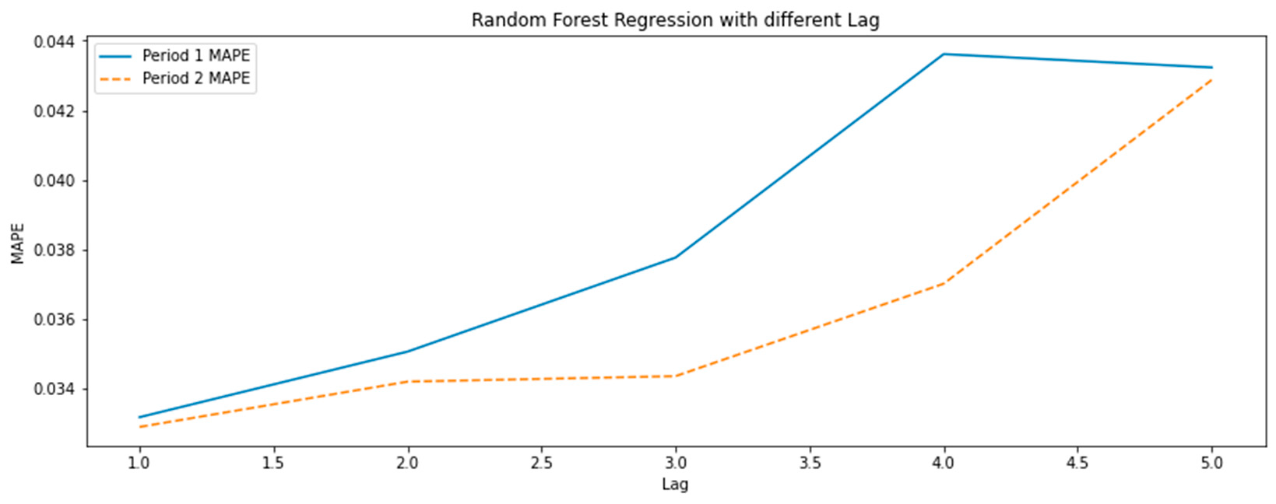
The Memory Problem
Lag 1 is Optimal:
• The research compared models using memory from 1 to 5 previous days (lags).
• Prediction accuracy was highest when using explanatory variables from only the immediate previous period (Lag 1).
The Problem with Long Memory:
• When older data (Lag 2+) was included, accuracy generally decreased.
• The forecast curve became "smoother," deviating from the real price.
• Conclusion: This supports the efficient market hypothesis—historical data beyond the latest period is largely irrelevant for short-term prediction
Figure 13. Relationship between MAPE and the number of lags (random forest regression).

Slide 18
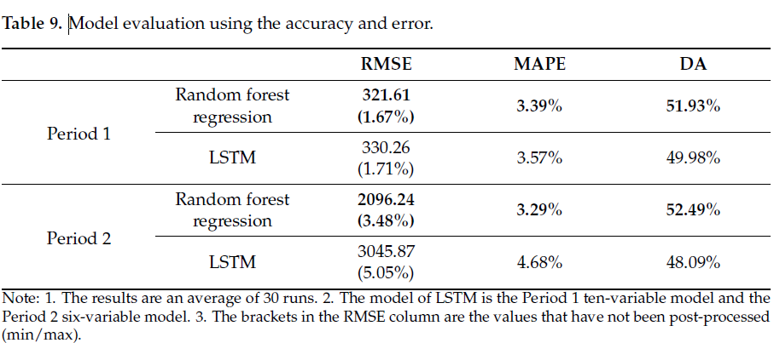
Conclusion and Next Steps
Actionable Conclusions:
• RFR is a Must-Try: We should integrate Random Forest Regression alongside LSTM and XGBoost for its accuracy and valuable variable importance output.
• Memory Constraint: We must enforce a Lag 1 data structure to maximize short-term prediction performance.
Future Project Expansion:
1. Shorter Time Intervals: Use 1-hour or 5-minute data instead of daily data to minimize forecast deviation over the 24-hour prediction period.
2. Automation: Implement an API interface for real-time data acquisition and automated prediction delivery to users

